Slide 1
Re-Engineering the Root of the DNS
Geoff Huston,
Chief Scientist APNIC

Slide 2
In this presentation
I’ll talk about the DNS, and the root server infrastructure in particular
And some recent initiative by APNIC to try and improve the situation

Slide 3
The Structure of the Domain Name System
The Domain Name System (DNS) is a distributed data collection using a delegation hierarchy that reflects the internal hierarchical structure of domain names. At each level in the name hierarchy each label represents a potential point of administrative delegation
. (“root”) zone
com. zone
www.example.com.
example.com. zone
www.example.com.

Slide 4
The Structure of the Domain Name System
The Domain Name System (DNS) is a distributed data collection using a delegation hierarchy that reflects the internal hierarchical structure of domain names. At each level in the name hierarchy each label represents a potential point of administrative delegation
. (“root”) zone
Delegation of the label “com”
com. zone
www.example.com.
Delegation of the label “example”
Each zone contains a list of defined labels
Labels can either reflect a delegation to a subordinate zone or they can be a terminal label that contains attribute information associated with that label
example.com. zone
terminal label “www”
www.example.com.

Slide 5
DNS Name Servers
Every DNS zone has a set of authoritative servers that can answer queries for names defined by that zone
The Root Zone is just another zone in that respect, and the authoritative servers for that zone are called “Root Servers”
  There are 13 Root Server names
  And these names are used to label Anycast Name Server constellations
  Which means that there are probably some thousands of discrete Root Server instances if you could peek inside all of these these anycast clouds

Slide 6
Resolving a DNS Name
Your resolver needs need to ask a DNS server for the zone that contains the terminal label for the associated information (resource record) associated with the DNS name
But…
  Where exactly is the zone cut?
  Who are the servers?
So resolvers discover this information by performing a top-down iterative search…

Slide 7
Resolving a DNS Name
Qname: www.example.com.?
. (“root”) zone server
Response: servers for the com. zone

Slide 8
Resolving a DNS Name
Qname: www.example.com.?
. (“root”) zone server
Response: servers for the com. zone
Qname: www.example.com.?
com. zone server
Response: servers for the example.com. zone

Slide 9
Resolving a DNS Name
Qname: www.example.com.?
. (“root”) zone server
Response: servers for the com. zone
Qname: www.example.com.?
com. zone server
Response: servers for the example.com. zone
Qname: www.example.com.?
example.com. zone server
terminal label
Response: Resource records for terminal label
www.example.com.

Slide 10
Resolving a DNS Name
Every DNS resolution procedure starts with a query to the root!
Qname: www.example.com.?
. (“root”) zone server
Response: servers for the com. zone
Qname: www.example.com.?
com. zone server
Response: servers for the example.com. zone
Qname: www.example.com.?
example.com. zone server
terminal label
Response: Resource records for terminal label
www.example.com.

Slide 11

How to be bad
Every DNS resolution procedure starts with a query to the root!
If an attacker could prevent the root servers from answering DNS queries then the entire Internet will suffer!

Slide 12
Caching in the DNS
The main role of the root server system is to answer queries that are not cached in local name caches
The vast majority of the queries that are passed to the root zone servers (some 2/3 of root queries) generate a “no-such-name” (NXDOMAIN) response from the root system

Slide 13
How to be bad
To attack the root servers you need to get past DNS resolver caches.
This means you need to have every query in the DNS attack flow ask for a different non-existent name

Slide 14
Root Servers are a highly visible attack target

Slide 15
Root Servers are a highly visible attack target

Slide 16
Root Servers are a highly visible attack target
If you can prevent resolvers from getting answers from the root then the resolvers will stop answering queries as their local cache expires

Slide 17
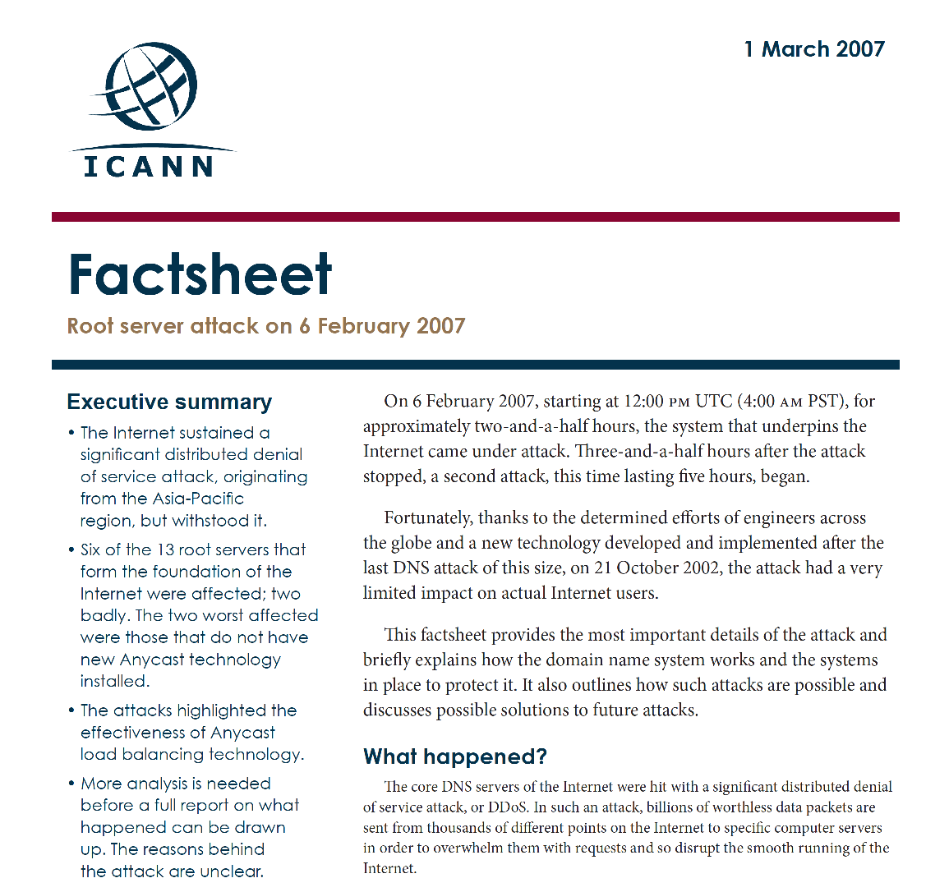
Root Servers are a highly visible attack target
If you can prevent resolvers from asking the root then the resolvers will stop answering queries as their cached responses expire

Slide 18
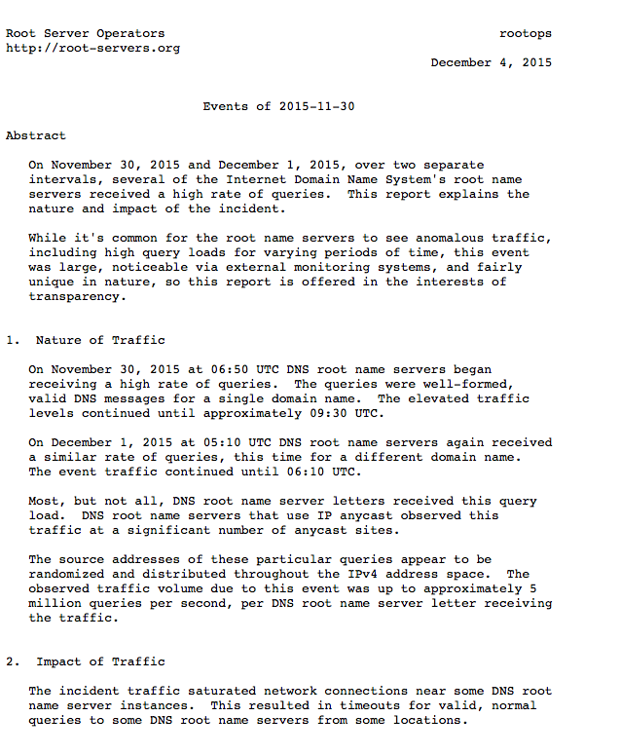
Root Servers are a highly visible attack target
If you can prevent resolvers from asking the root then the resolvers will stop answering queries as their cached responses expire

Slide 19
How should we defend the Root?
Larger Root Server platforms?
More Root Server Letters?
More Anycast Instances?
Change Root Server response behaviours?
Or…

Slide 20
How should we defend the Root?
Can’t scale *
Larger Root Server platforms?
More Root Server Letters?
More Anycast Instances?
Change Root Server response behaviours?
Or…
* Distributed parallel attacks can scale up in intensity more effectively than a single point of service can scale its defence mechanisms

Slide 21
How should we defend the Root?
Can’t scale
Larger Root Server platforms?
More Root Server Letters?
More Anycast Instances?
Change Root Server response behaviours?
Or…
Err, umm – well no *
* The limit of 13 distinct root server names is an inherited limit that these days has a political dimension that has largely supersedes the original technical reasons for the limit. In any case more letters is not a very good DDOS defence!

Slide 22
How should we defend the Root?
Can’t scale
Larger Root Server platforms?
More Root Server Letters?
More Anycast Instances?
Change Root Server response behaviours?
Or…
Err, umm – well no *
Today’s practice for root servers

Slide 23
Anycast Root Servers
12 of the 13 root server “letters” operate some form of “anycast” server constellation. All the servers in a constellation respond to the same public IP addresses. The routing system will direct resolvers to pass their query to a particular root letter to the “closest” member of the letter’s anycast constellation.
Anycast provides:
  faster responses to queries to the root for many DNS resolvers
  Greater resilience to hostile traffic by load sharing widely distributed attacks across the entire anycast constellation, and absorbing a single point attack on a single server instance

Slide 24
Anycast Root Servers
12 of the 13 root server “letters” operate some form of “anycast” server constellation. All the servers in a constellation respond to the same public IP addresses. The routing system will direct resolvers to pass their query to a particular root letter to the “closest” member of the letter’s anycast constellation.
Anycast provides:
  faster responses to queries to the root for many DNS resolvers
  Greater resilience to hostile traffic by load sharing widely distributed attacks across the entire anycast constellation, and absorbing a single point attack on a single server instance
Anycast is more about more effective defence against DDOS attack and not about any marginal changes in resolution performance that anycast may offer

Slide 25
How do we defend the Root today?
As the traffic levels to the root servers increases both as steady state query levels and instances of attacks, we keep on adding more instances to the existing anycast clouds

Slide 26

The attacks get bigger

Slide 27


Our defence is bigger walls

Slide 28

The attackers are our own recursive resolvers!
We are scaling the DNS root server infrastructure in order to be resilient against floods of queries about non-existent names coming from the existing DNS resolvers, who are scaling their own capabilities to survive the very same query attacks that are being directed against them!

Slide 29
How do we defend the Root today?
As the traffic levels to the root servers increases both as steady state query levels and instances of attacks, we keep on adding more instances to the existing anycast clouds
What we are in effect doing is building ever bigger and larger trash processors to handle ever larger amounts of garbage queries to cope with these ever larger attacks

Slide 30
Can we jump out of this vicious cycle?
Can we change the behaviour of the DNS system to improve both its service and its resilience?

Slide 31
DNSSEC changes Everything
Before DNSSEC we relied on the assumption that if we asked an IP address of a root server, then the response was genuine
With DNSSEC we can ask anyone, and then use DNSSEC validation to assure ourselves that the answer is genuine
How can we use this?

Slide 32
DNSSEC-Enabled Directions for the Root Service
If we could answer NXDOMAIN queries from recursive resolvers we could reduce the load on the root servers by close to 70%
This would be a very significant win:
  reducing root query traffic
  providing faster response to these queries
  reduces the local cache load on recursive resolvers

Slide 33
Local Root Secondaries – RFC 7706
Enlist DNS resolvers to offer a root zone secondary service
If resolvers use this approach then they only need to query a root server infrequently and perform a zone transfer of the current state of the root zone (IXFR from a root server), and use this validated copy of the root zone to directly answer all queries that refer to the root zone

Slide 34
NSEC caching – RFC 8198
Most of the queries seen at the root are for non-existent domains, and resolvers cache the non-existence of a given name
But a DNSSEC-signed NXDOMAIN response from the root zone actually describes a range of labels that do not exist, and it’s the range that is signed, not the actual query name
If resolvers cached this range and the signed response, then they could use the same signed response to locally answer a query for any name that falls within the same label range
This has a similar effect to RFC7706, but without any configuration overhead, nor is there any requirement for supporting root zone transfers.

Slide 35
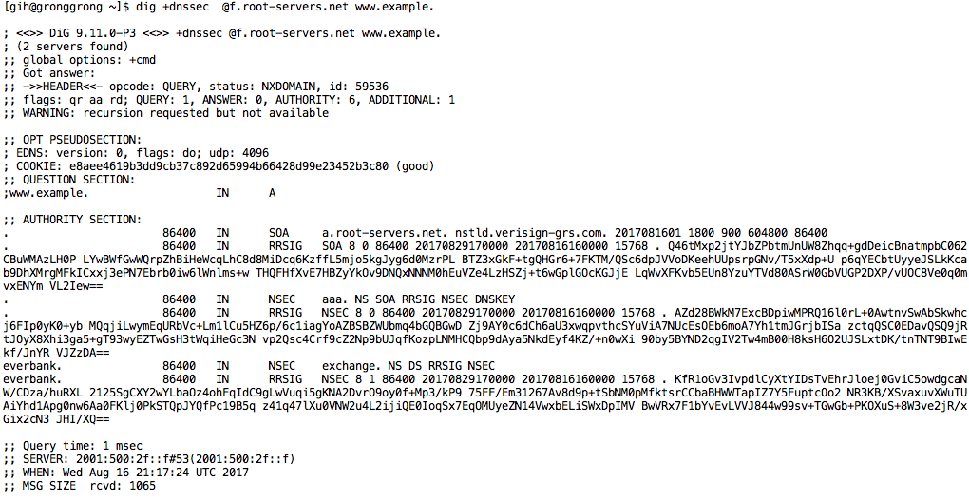
NSEC caching
For example, if you were to query the root server for the non-existant name www.example. the returned response from the root says that there are NO TLDS between everbank. and exchange.
The same response can be used to respond to queries for every TLD between these labels.
So we can cache this range response and use it to respond to subsequent queries that fall into the same range

Slide 36
Architecturally speaking…
Rather than have recursive resolvers act as “amplifiers” for DNS queries for non-existent names, NSEC caching enlists these recursive resolvers to act on behalf of the root servers, and provide the answers for them.
This approach uses existing DNS functionality and existing queries – there is nothing new in this.
The change here is to take advantage of the use of the NSEC response to define a range of names, allowing what is in effect semi-wildcard cache entries that can be used to respond to a range of query labels

Slide 37
Impacts…
Rather than trying to expand the capabilities of the root zone servers, we can leverage the massive number of already deployed recursive resolvers to extend their cache to cover both defined and non-existant root labels
We anticipate that this will have a major effect on the DNS by absorbing most of the current root query load at the edge, rather than passing these queries into the root system

Slide 38
Impacts…
NSEC caching can also help recursive resolvers
Instead of caching non-existent individual names they can cache the NSEC-described range, and refresh the cached NSEC record instead of any individual name
This will shrink the demands placed on the local cache, which can improve local cache performance in the recursive resolver

Slide 39
Coming to a Bind Resolver near you
APNIC has sponsored the inclusion of this NSEC caching code for the root zone in the forthcoming Bind 9.12 release
This function will be enabled by default in this release
We hope that other DNS resolver vendors also implement this feature, as widespread use of NSEC caching will have a dramatic positive impact on the root server ecosystem!

