Slide 1

Network Analytics
Geoff Huston, George Michaelson
APNIC

Slide 2
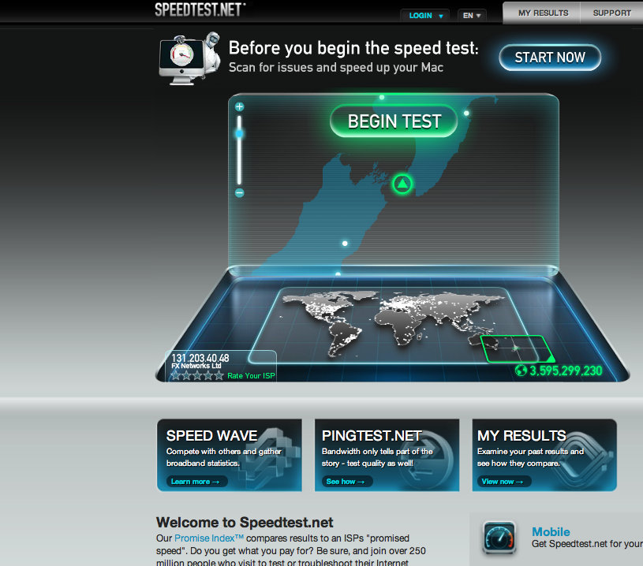

Slide 3


How to measure “the Internet”
What do we mean when we say
  “we’re measuring the Internet?”

Slide 4

User experience
  Responsiveness
  Sustained Throughput
  Application performance quality
  Consistency
  Availability
Network Behaviour
  Routing Stability
  Path characteristics
Element Behaviour
  Subnet characteristics
  Switch element behaviour
  Switch resource consumption
Network availability
  Element availability
  Transmission path availability
  Transmission element BER
  Network path availability
Path characteristics
  Latency
  Jitter characteristics
  Loss characteristics
Protocol behaviour
  Transport protocol behaviour
  IPv6 penetration levels
  Failover behaviour
  Connection failures
And so on...

Slide 5
What are you trying to measure?
User experience
  Responsiveness
  Sustained Throughput
  Application performance quality
  Consistency
  Availability
Network Behaviour
  Routing Stability
  Path characteristics
Element Behaviour
  Subnet characteristics
  Switch element behaviour
  Switch resource consumption
Network availability
  Element availability
  Transmission path availability
  Transmission element BER
  Network path availability
Path characteristics
  Latency
  Jitter characteristics
  Loss characteristics
Protocol behaviour
  Transport protocol behaviour
  IPv6 penetration levels
  Failover behaviour
  Connection failures
And so on...

Slide 6
Network Measurement Approaches
PING and related probe techniques
  Send an ICMP echo request to a target device and measure the time to respond
  Often used to interpret some indication of delay, loss and jitter
  BUT has little relationship to application performance, as the probe measurement is heavily impacted by the behaviour of the probe and the echo point
    i.e. beyond being a remote device availability beacon, its of little practical use

Slide 7
Network Measurement Approaches
SNMP
  Per-element probe to poll various aspects of an element’s current status
  Of little practical value in determining end-to-end network performance, as there is a distinct gap between end-to-end path performance and periodic polling of network element state

Slide 8
Network Measurement Approaches
Active Test Traffic
  Perform a particular network transaction in a periodic fashion and correlate application performance across invocations
  Often measures the performance limitations of the test gear and the target rather than the network
  Tests only a small number of network transit paths
  Provides only a weak correlation between measurement results and actual end-user experiences of application performance

Slide 9
What, Where and Why?
Using a combination of active and passive measurement techniques there is a massive set of possible aspects of network behaviour that can be measured
Few network measurements have any real bearing on the performance characteristics of applications that include some form of network interaction
  i.e. there’s a difference between measuring any old thing and measuring something relevant and useful
If you are going to measure something…
  Know why you are measuring it
  Understand the limitations of the measurement technique
  Understand the limitations of any interpretation of the measurement
  Understand who is the consumer of the measurement

Slide 10
IP Performance
The end-to-end architectural principle of IP:
  The network should not duplicate or mimic functionality that can or should be provided through end-to-end transport-level signalling
  Wired IP networks can be seen as lossy queue-controlled passive switching devices connected through fixed delay channels
  Wireless IP networks are worse!
IP parameters:
  Delay
  Delay stability
  Jitter
  Loss rate
  Loss burstiness
In general the smaller the numbers the better, but ...

Slide 11
TCP Performance
TCP performance is the interaction of concurrent end-to-end transport sessions performing a role of mutually enforced resource sharing
  The network is not a mediator or controller of an application’s resource requirements
Its a lot like fluid dynamics:
  Each network transport flow behaves in a fair greedy fashion, consuming as much of the network’s resources as other concurrent network transport applications will permit

Slide 12
Maybe asking how to measure “network performance” is the wrong question
How well your car operates is an interaction between the functions and characteristics of the car and the characteristics of the road – trip performance is not just the quality or otherwise of the road
How well an application operates across a network is also an interaction between the application and the local host and the interaction by its remote counterparts and their hosts as well as the interaction between the application’s transport drivers and other concurrent applications that occur within the network

Slide 13
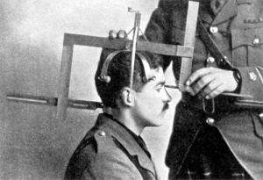
How to measure the end user

Slide 14
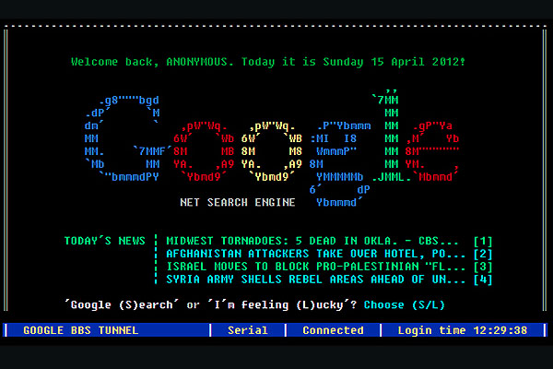
Anatomy of a web page fetch (1990s)

Slide 15
Anatomy of a web page fetch (1990s)
Client issues HTTP connect
:
Client issues “GET”
:
Client receives HTML stream in HTTP
Client disconnects
Server listens
Server accepts
responds 200 ok
Server receives, finds URL on disk, sends contents
:
:
Server exits and back to listen()

Slide 16

Anatomy of a web page fetch (2010s)

Slide 17
Anatomy of a web page fetch (2010s)
User visits URL in browser
Cached content pre-displayed
Cookies, JavaScript, Flash runs, decides what to display to user
Web page viewable
:
:
:
Maybe never Complete
Client issues several HTTP connects in parallel
:
Client does handshake over capabilities, header checks, tries to find cached content
:
Client receives HTML stream in HTTP
Client disconnects
Server listens
Server accepts
responds 200 ok
Server receives, finds URL on disk, sends contents
:
:
Server exits and back to listen()

Slide 18
HTTP/HTML ain’t what it used to be
A huge amount of parallelism/asynchrony has been introduced.
Intermediate processing takes place on the stream of data, deciding what to display and what not to display
  Adblock, flashblock, cache-optimizations
  Document Object Model (DOM) includes material not displayed, material not added to DOM by scripts &c
JavaScript provides rich language including timers, async fetches, string/number processing

Slide 19


Observations
Most networks are a collection of elephants and rats
  And the elephants are uncontrollable
  And the rats breed like crazy
If all the traffic is TCP then a well tuned client and server should drive a network to the point of packet loss
  The resultant overall packet loss rate is a function of the average RTT and the average size of network transactions
If all the traffic is real time streaming then congestion events can become catastrophic

Slide 20
Approaches to Measurement...
Measure the network
  And claim that perfection is in the eye of the network management system
  And everything else is a user problem!
This approach has its weaknesses
Or you can measure the end user...

Slide 21

Approaches to Measurement...
From the inside looking out
  Set up a measurement station
    Ping, traceroute and fetch routines
    Measure the absolute outcomes and the variance
  Its not really a user metric
    It’s not that bad
    But its not that useful either

Slide 22

Approaches to Measurement...
From the outside looking in:
  Set up a measurement station
    Enrol end users to send traffic to it
    Measure the absolute outcomes and the variance
  Or instrument your web server
  Its not a bad metric
    But its a small sample set that is often nerd heavy
    And nerds are “special”

Slide 23
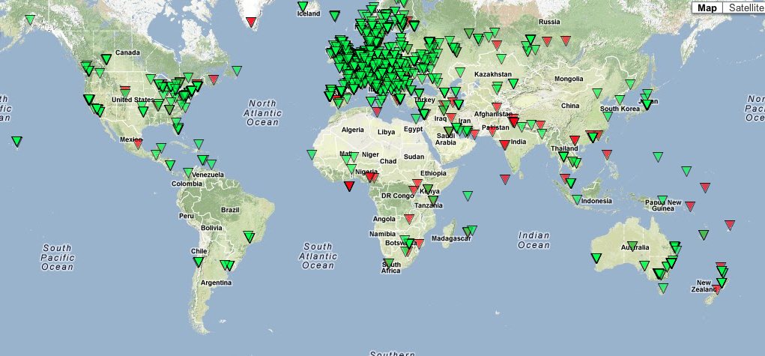
Approaches to Measurement...
From the outside looking in
  RIPE Altas
    Many thousands of end points installed in end user networks
    Ping and traceroute to a small set of destinations
    And report back
    Analysing the data to produce relevant outcomes is a challenge

Slide 24

Approaches to Measurement...
From the outside looking in
  The “Sam Knows” approach
    “be the user”
    Use a known common platform (Open WRT DSL modem)
    Use a common set of tests (short and large data transfer)
    Take over the user’s connection and perform the tests at regular intervals
    Report results
  Originally developed to test DSL claims in the UK
  Used by the FCC and ISPs in the US
  Underway in Singapore and in Europe

Slide 25

Observations
IP performance measurement is not a well understood activity with mature tools and a coherent understanding of how to interpret various metrics that may be pulled out from hosts and networks
The complex interaction of applications, host systems, protocols, network switches and transmission systems is at best only weakly understood
  But there’s a lot of slideware out there claiming to provide The Answer!

Slide 26
Approaches to Measurement
A case study: APNIC’s approach
we wanted to measure IPv6 deployment as seen by end users
We wanted to say something about ALL users
So we were looking at a way to sample end users in a random but statistically significant fashion
We stumbled across the advertising networks...

Slide 27


…buy the users

Slide 28
Placement
At low CPM, the advertising network needs to present unique, new eyeballs to harvest impressions and take your money.
  Therefore, a ‘good’ advertising network provides fresh crop of unique clients per day

Slide 29
Unique IPS?
Collect list of unique IP addresses seen
  Per day
  Since inception
Plot to see behaviours of system
  Do we see ‘same eyeballs’ all the time?

Slide 30
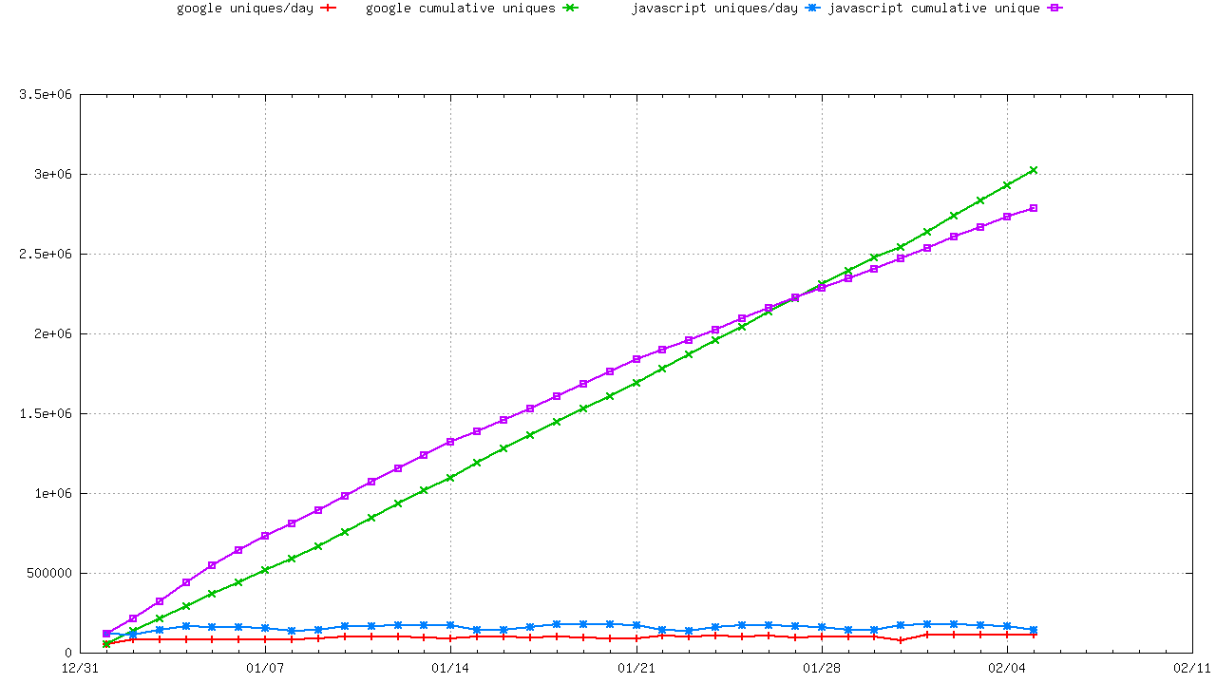
Lots of Unique IP’S
Unique IPs via Ads
Unique IPs via Web Sites

Slide 31
Dealing with the data
Unified web, dns, tcp dumps
Measure:
  IPv6 update rates
  RTT measurements
  Connection Drop rate
  Approx 800,000 experiments/day
Post-process to add
  Economy of registration (RIR delegated stats)
  Covering prefix and origin-AS (bgp logs for that day)
Combine into weekly, monthly datasets (<10Mb)

Slide 32

What are we finding?

Slide 33
What are we finding?
http://labs.apnic.net/ipv6_measurement
  Breakdowns by ASN, Economy, Region, Organisation
  JSON and CSV datasets for every graph produced, on a stable URL
  Coming soon: single fetch of the dataset for bigtable map/reduce
125+ economies provide >200 samples/interval consistently in weeklies, 150+ at monthlies.
  Law of diminishing returns as more data collected
  200 is somewhat arbitrary, but provides for 0.005 level measure if we get one-in-200 hit.
  Beyond this, data is insufficient to measure lowside IPv6 preference

Slide 34

Google visualization API
G
GLE

Slide 35
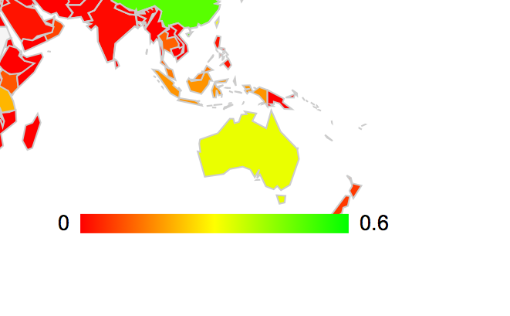

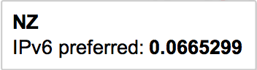
Google visualization API

Slide 36
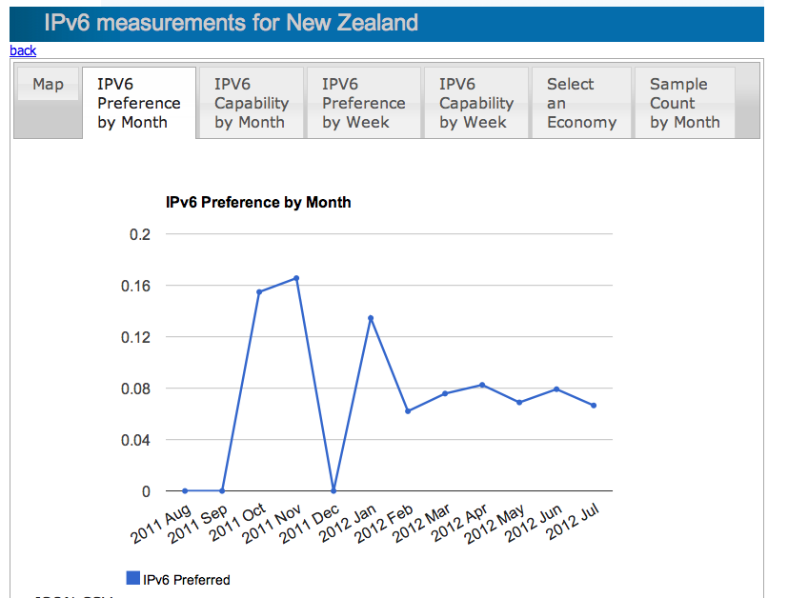
Google visualization API

Slide 37
IPv6 measurement
Penetration rate of IPv6 into the global AS economy is slow
No signs of ‘game changer’ flip to IPv6 at the end-user yet
Widely distributed hop-over for IPv6 being seen.
  due to the CPE gap ?
  Even IPv6 enabled ISPs have customers tunnelling over the air-gap
Much more information about IPv6, global internet behaviour is in the data
  “watch this space” –long-term investment in measurement, ongoing.
  Better datasets, BigTable map/reduce
  Collaborations with “the usual suspects” to extend the experiment

Slide 38
Conclusions
Understand WHY you want to conduct a measurement exercise
Understand the LIMITATIONS of any measurement program
Understand the CONTEXT of the measurement
You can either take your data and bend the analysis to suit today’s question
Or try and understand what data sets and measurement methodology might directly address your question

Slide 39


Thank You
Discussion?
labs

